Slide 1
DATA VISUALIZATION IN R
Nguyen Minh Hoang
29/07/2023

Slide 2
Contents
Data types
Data structure
Import and export data
4. Data visualization
5. Homework

Slide 3
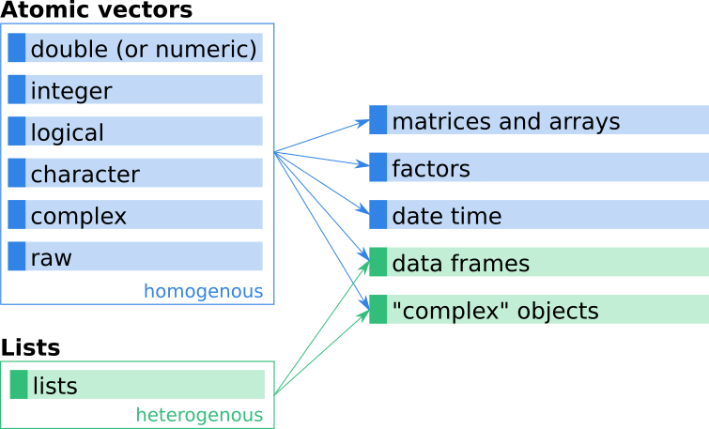
DIFERENT R OBJECTS
https://discdown.org/rprogramming/vectors.html

Slide 4
DATA TYPES IN R

Slide 5
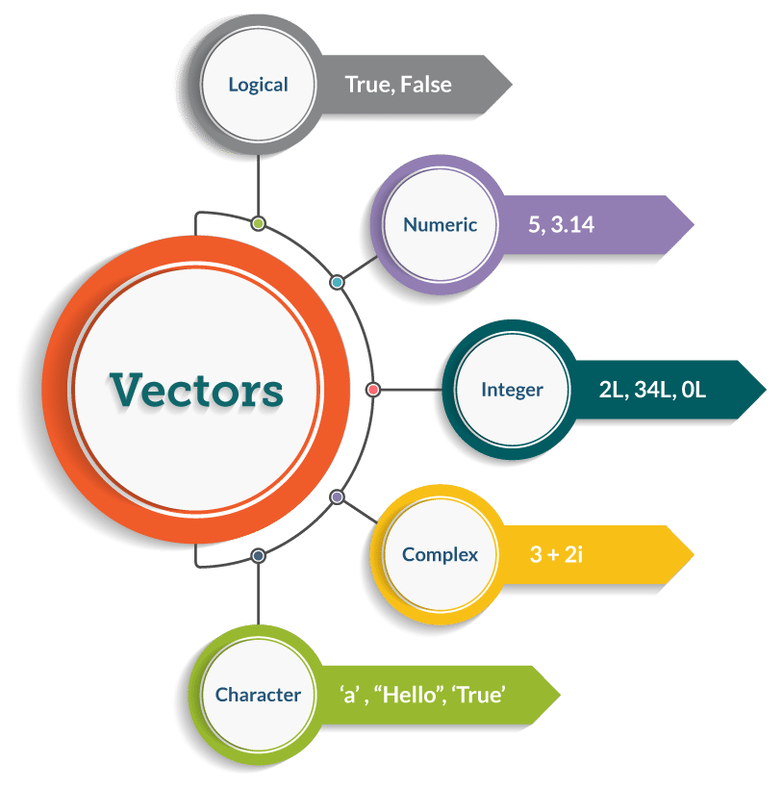
DATA TYPES IN R
https://www.edureka.co/blog/r-programming-language

Slide 6
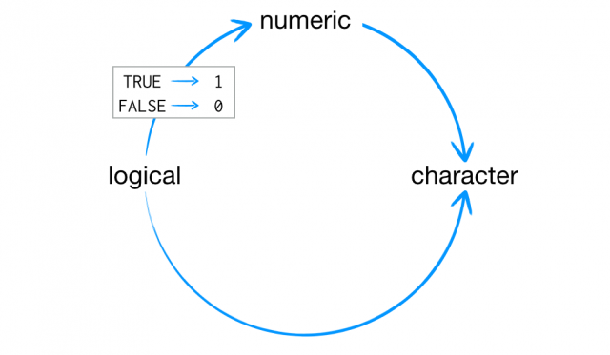
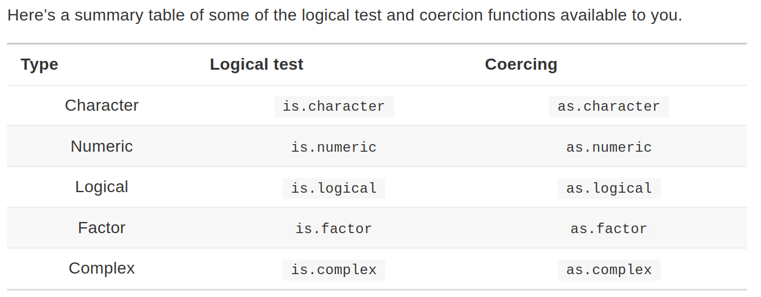
What is Coercion in R?
https://www.zigya.com/blog/what-is-coercion-in-r/

Slide 7
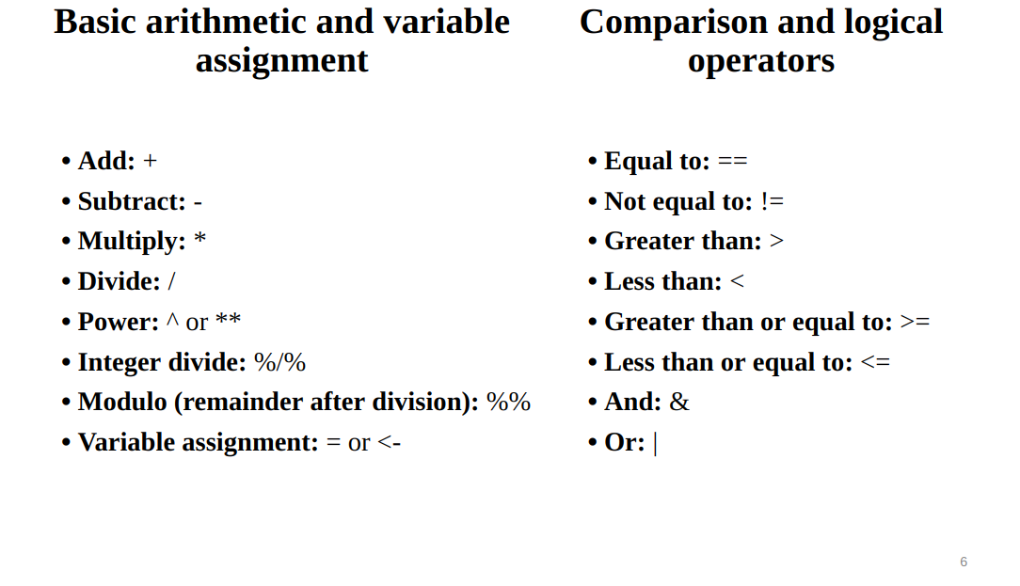
Caculation and Comparison in R

Slide 8
DATA STRUCTURES IN R

Slide 9
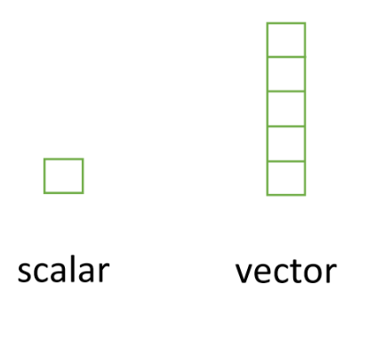
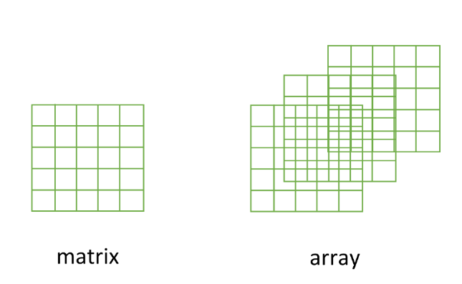
DATA STRUCTURES IN R
Scalars and vectors
Matrices and arrays

Slide 10
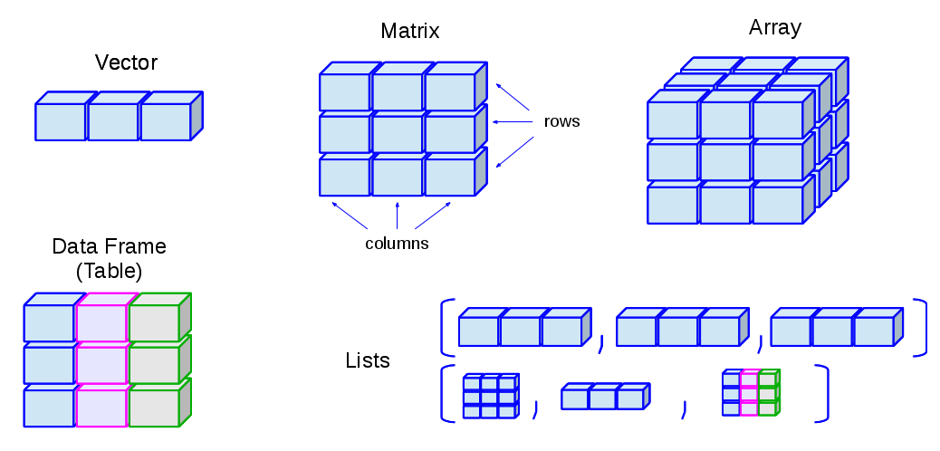
DATA STRUCTURES IN R
http://venus.ifca.unican.es/Rintro/dataStruct.html

Slide 11
Importing data

Slide 12
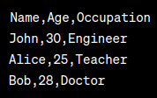
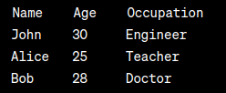
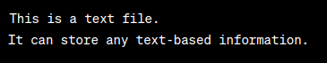
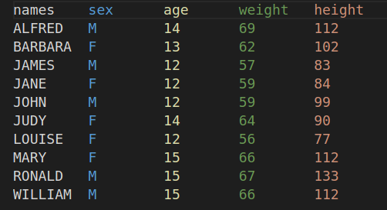
FILE TYPES
CSV (Comma-Separated Values): CSV files are plain text files that store tabular data, with each line representing a row of data, and values separated by commas (or other delimiters). CSV is one of the most widely used formats for exchanging data between different applications because of its simplicity and compatibility.
TSV (Tab-Separated Values): TSV files are similar to CSV files but use tabs as the delimiter between values instead of commas. TSV files are also plain text files and are often used when data includes commas within the values.
TXT (Text File): TXT files are plain text files that do not have a standardized format for storing tabular data. They can be used to store any text-based information but do not have specific rules for structuring tabular data like CSV or TSV.
Excel Files (XLS, XLSX): Microsoft Excel files that can store tabular data in multiple sheets along with formatting, formulas, and charts. XLS is the older format used by Excel versions before 2007, while XLSX is the newer XML-based format used by Excel 2007 and later.
CSV
TSV
TXT

Slide 13
READ SINGLE FILE IN R
Importing a CSV file in R
data_1 <- read_csv('path_to_file.csv', header=T)
data_2 <- read_table('path_to_file.csv', header=T)
Importing a TXT, TSV file in R
data_3 <- read.delim('path_to_file.txt',header = T)
Importing data from Excel into R
library(readxl)
data_4 <- read_excel("path_to_file.xlsx", sheet = 1)

Slide 14
install.packages(“data.table”) library(data.table)
DEAL WITH MUTLI LARGE DATASET
Why use data.table packages?
concise syntax: fast to type, fast to read
fast speed
memory efficient
careful API lifecycle management
community
feature rich
data <- fread('/home/acer/Downloads/dowload/data.tsv', header=T)
https://www.youtube.com/watch?v=opai4Wmp6Zo

Slide 15
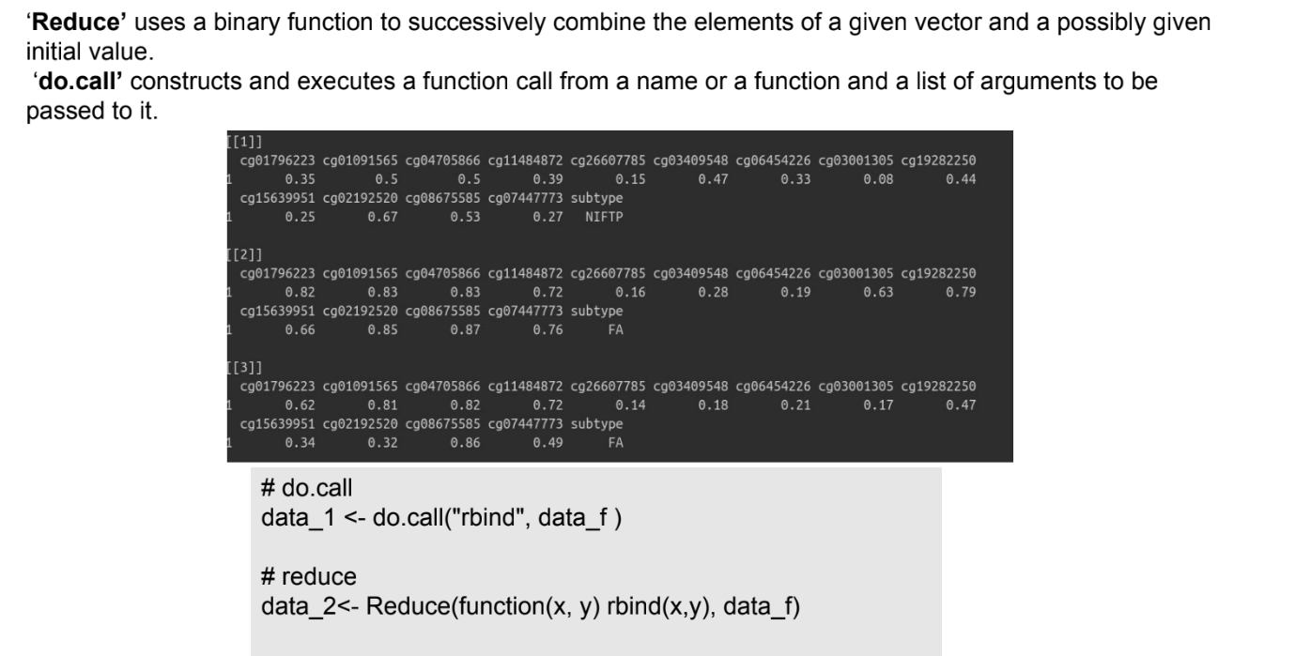
do.call vs. Reduce

Slide 16
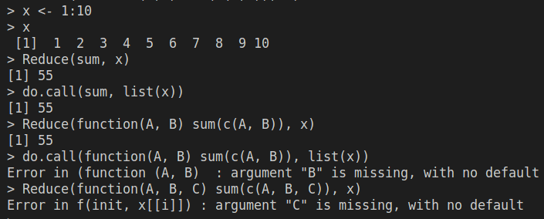
Compare do.call vs. Reduce
do.call () vs. Reduce() allow you to call any R function, but instead of writing out the arguments one by one, you can use a list to hold the arguments of the function.
Do.call | Reduce
apply function for all elements in list | Take 2 elements to apply function for each (only 2 element)

Slide 17
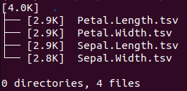
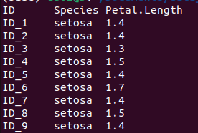
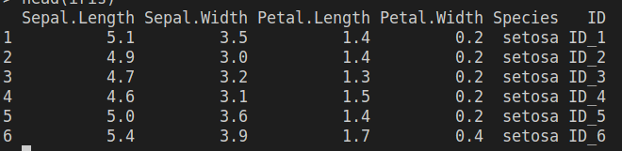
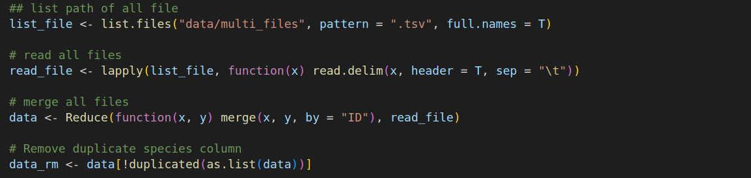
READ MUTLI FILES IN R
Target

Slide 18
EXPORT DATA IN R
Write data to txt file:
write.table(object, file = "name_file.txt", sep = "\t",row.names = TRUE, col.names = NA)
Write data to csv files
write.csv(object, file = "name_file.csv")
Writing data from R to Excel files
library("xlsx")
# Write the first data set in a new workbook
write.xlsx(USArrests, file = "myworkbook.xlsx", sheetName = "USA-ARRESTS", append = FALSE)
# Add a second data set in a new worksheet
write.xlsx(mtcars, file = "myworkbook.xlsx", sheetName="MTCARS", append=TRUE)

Slide 19
DATA VISULIAZTION

Slide 20
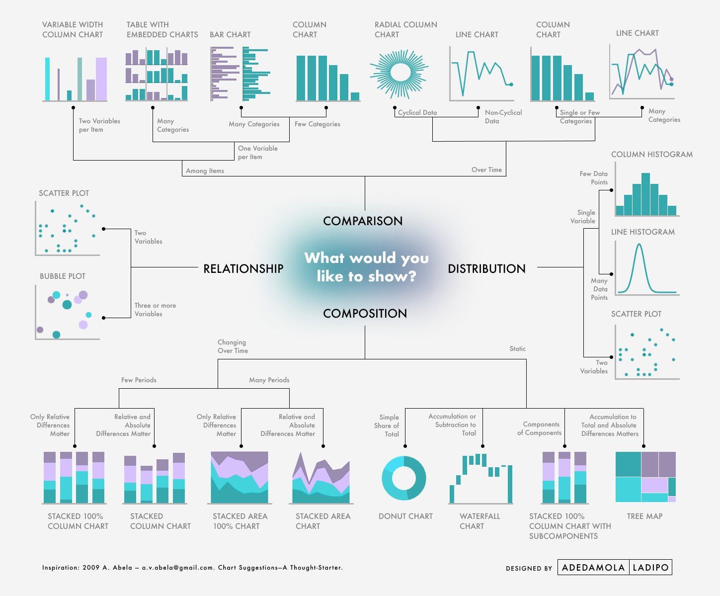
INTRODUCTION
THERE ARE FOUR BASIC PRESIONTATION TYPES THAT YOU CAN USE PRESENT YOUR DATA:
Comparison
Relationship
Distribution
Composition

Slide 21
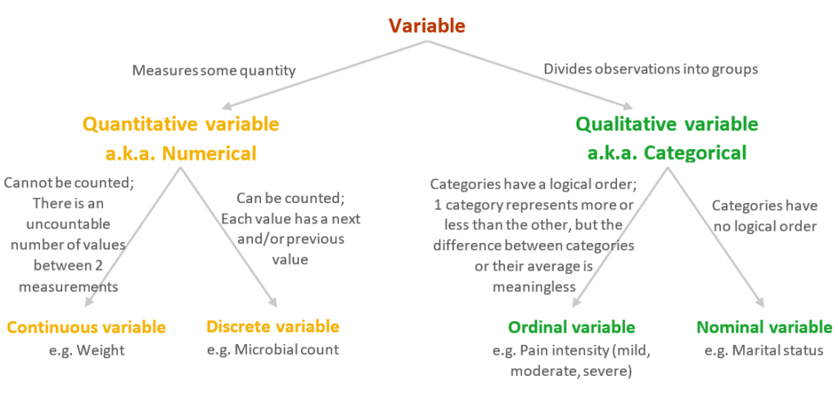
Variable Types
https://quantifyinghealth.com/variable-types/

Slide 22
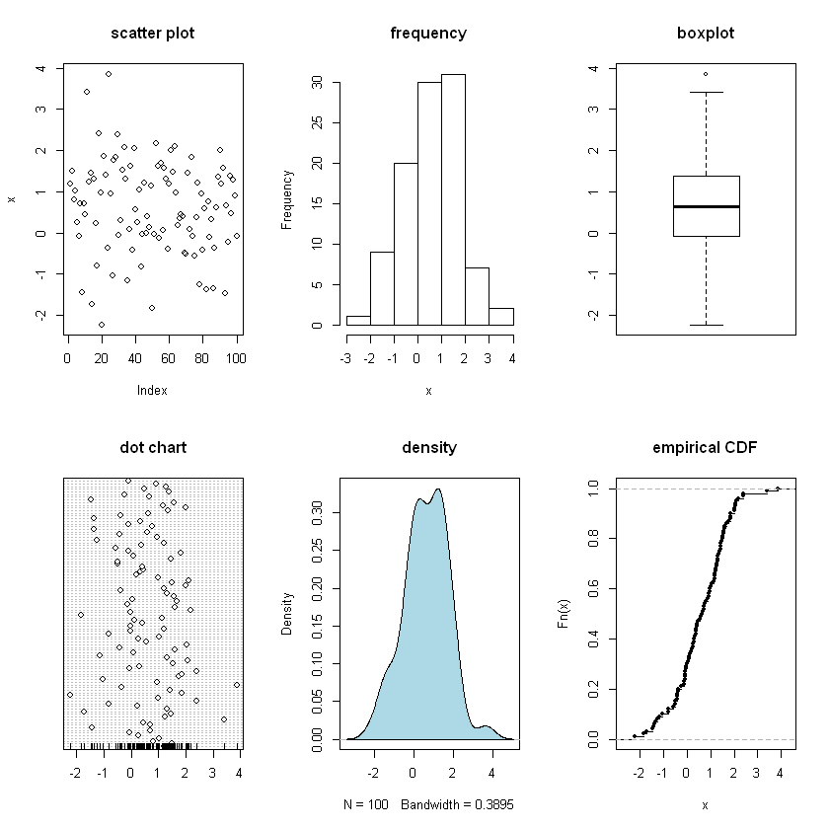
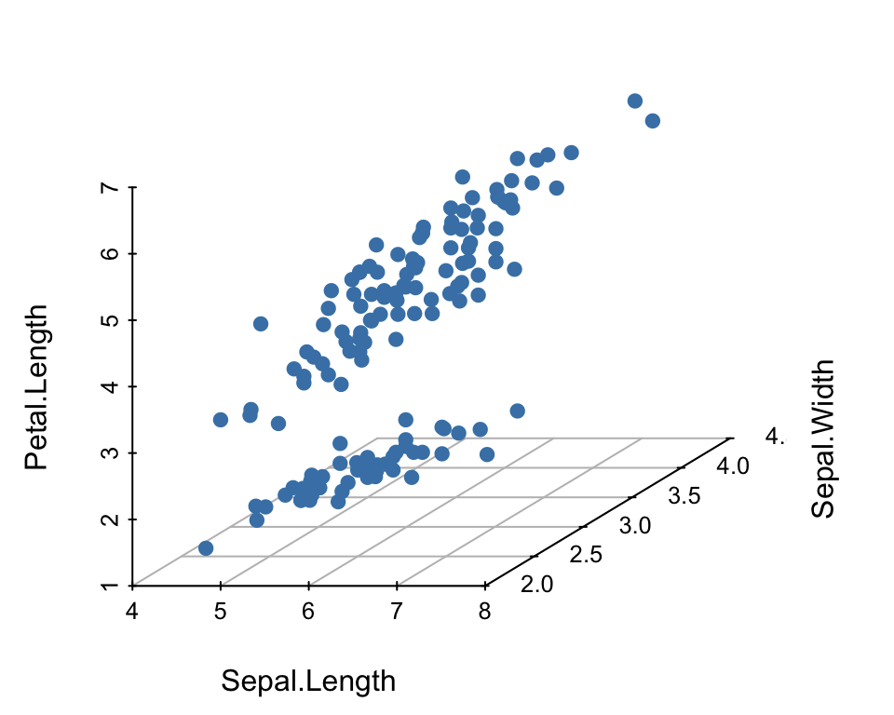
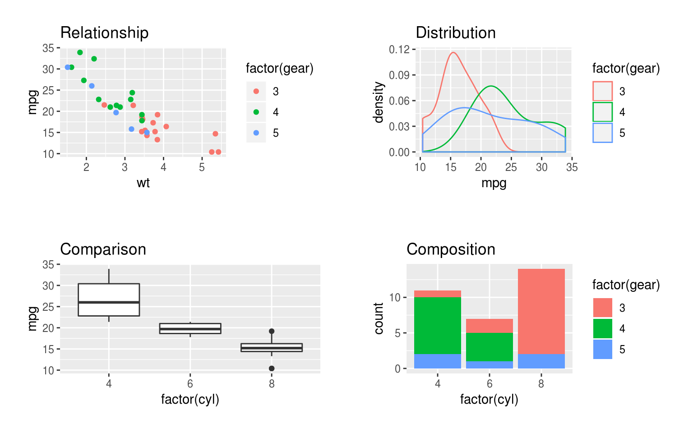
Univariate and Bivariate Graphs
Univariate analysis is when only one variable is analyzed.
Bivariate data analysis is when exactly two variables are analyzed.
Multivariate analysis is when more than two variables get analyzed.
Bivariate Graph
Multivariate graph
Univariate Graph

Slide 23
BASIC PLOT AND GGPLOT2

Slide 24
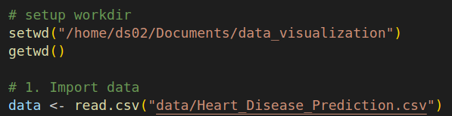
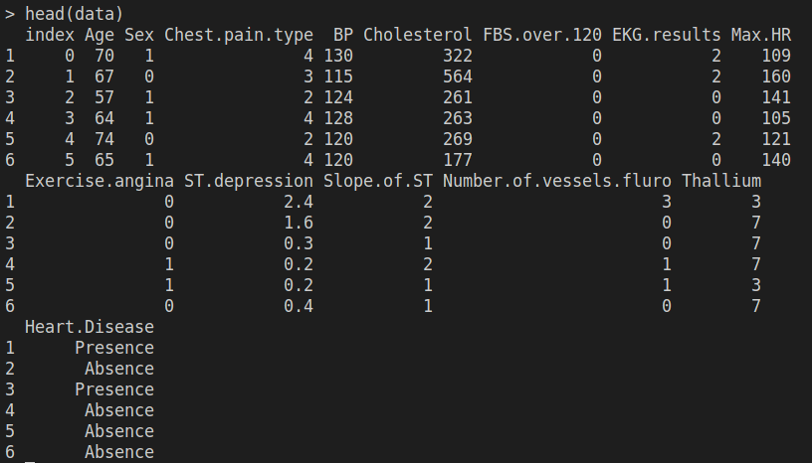
IMPORT DATA INTO R

Slide 25
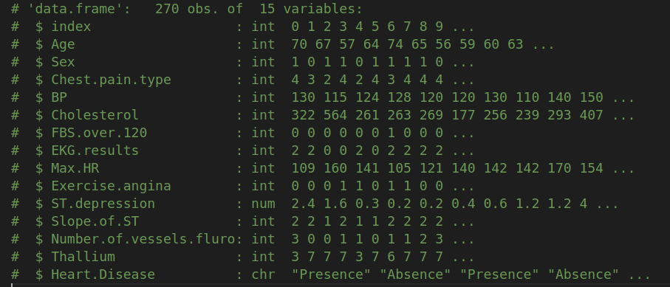
Introduce data in R
This dataset contains 270 case studies of individuals classified as either having or not having heart disease based on results from cardiac catheterizations - the gold standard in heart health assessment.
https://www.kaggle.com/datasets/thedevastator/predicting-heart-disease-risk-using-clinical-var

Slide 26
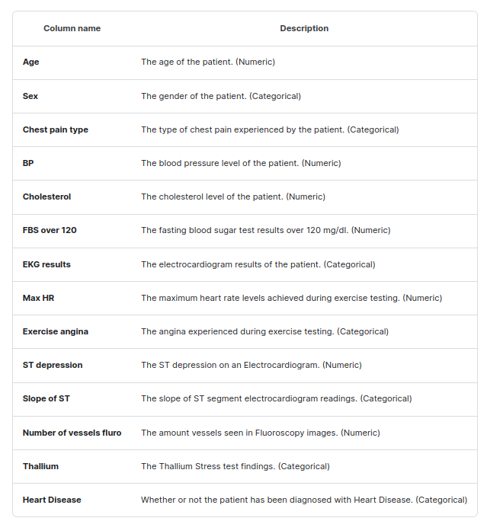
DESCRIBE DATASET

Slide 27
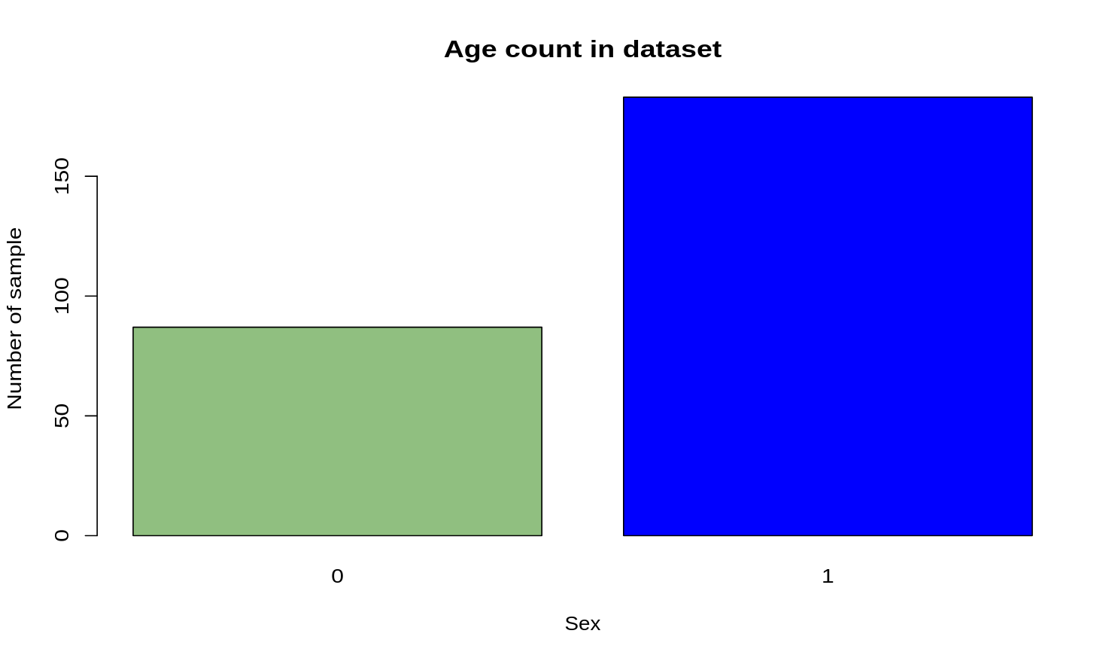
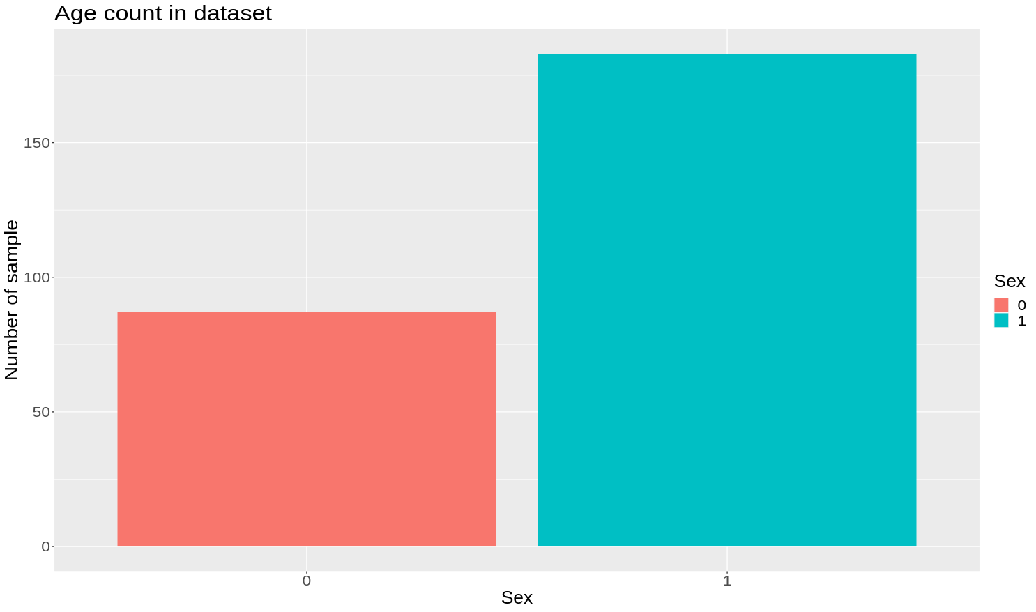
Barplot
Basic Plot
ggplot2 Plot
barplot(table(data$Sex),
ylab = "Number of sample", # add y label
xlab = "Sex", # add x label
main = "Age count in dataset", # add title for graph
col = c("#90bf80", "blue"), # add color
fill = c("pink")
)
ggplot(data, aes(as.factor(Sex), fill = as.factor(Sex))) +
geom_bar() + # select a type of plot
labs(x = "Sex", y = "Number of sample", title = "Age count in dataset") + # add title, x axis's name, y axis'name
guides(fill = guide_legend(title = "Sex")) +
theme(text = element_text(size = 20))

Slide 28
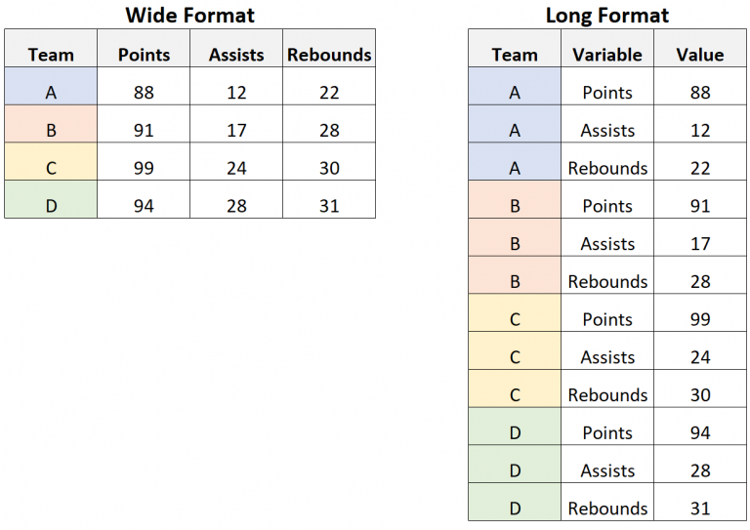
Reshape2::melt,dcast
long_df <- melt(w_data, id = "team")
rw_data <- dcast(long_df, team ~ variable)
https://ademos.people.uic.edu/Chapter8.html

Slide 29
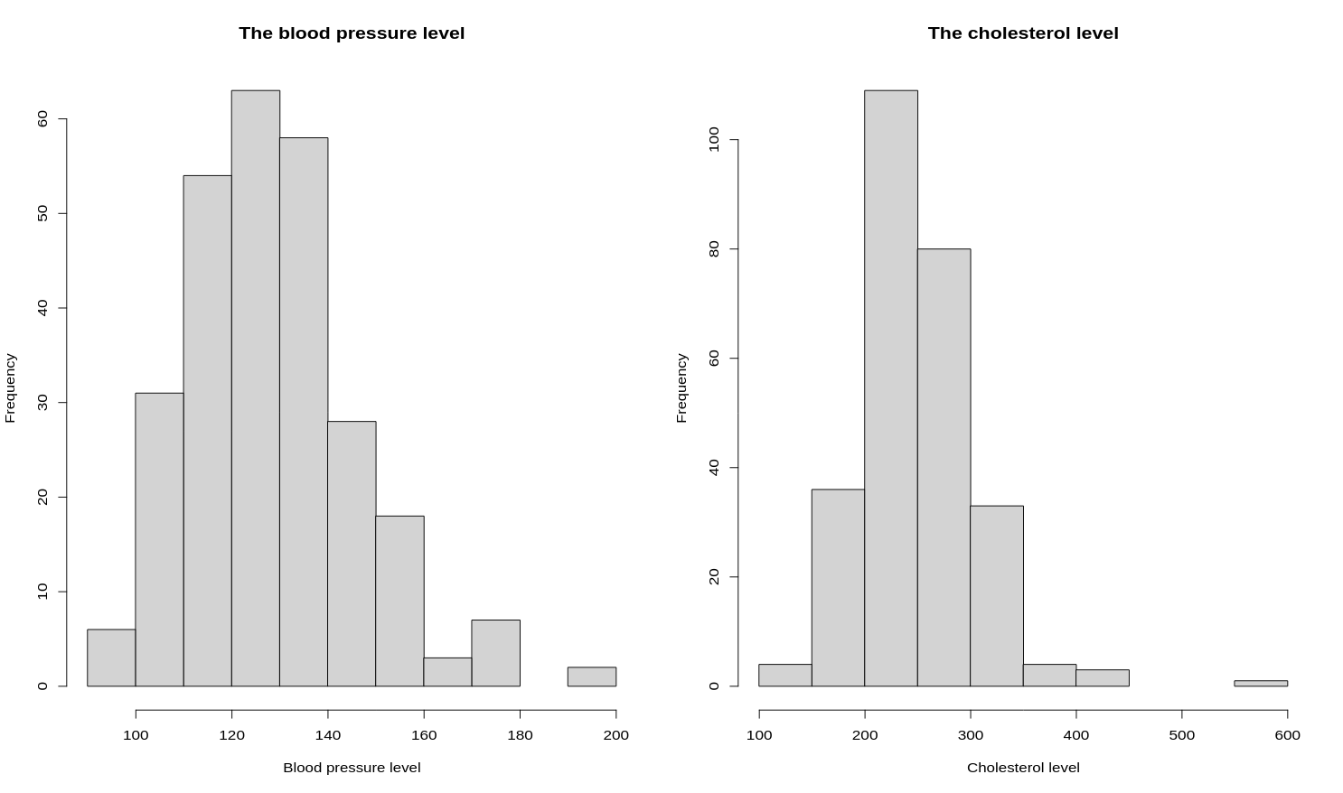
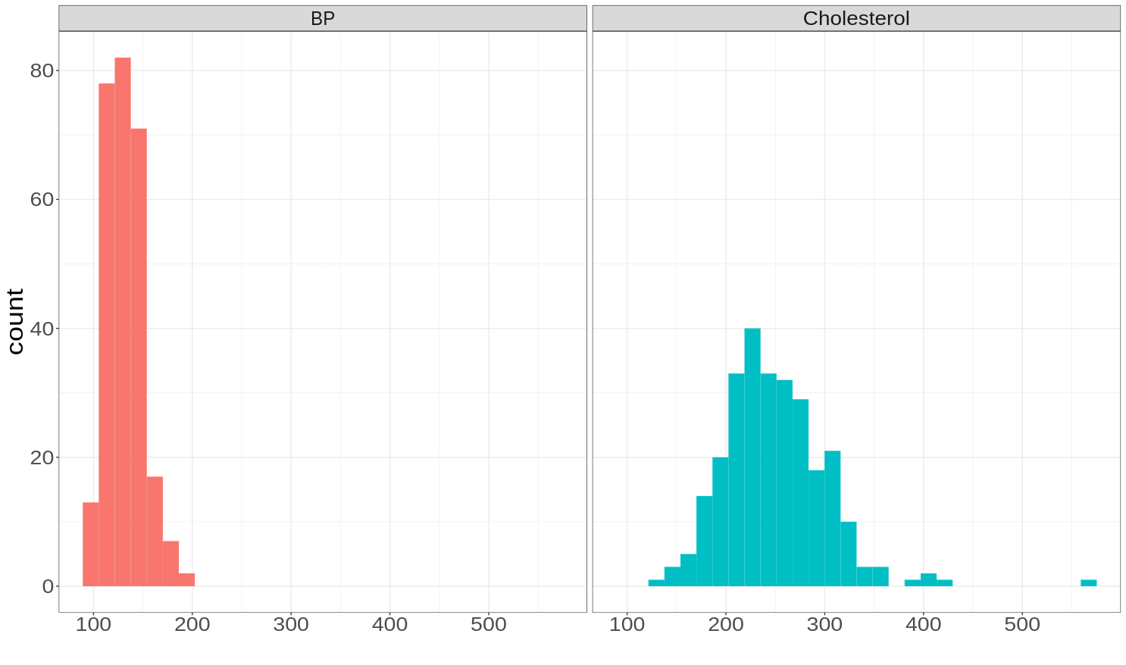
Histograms
Basic Plot
ggplot2 Plot
par(mfrow = c(1, 2))
hist(data$BP,
main = "The blood pressure level",
xlab = "Blood pressure level"
)
hist(data$Cholesterol,
main = "The cholesterol level",
xlab = "Cholesterol level"
)
ggplot(mdata_sub, aes(value, fill = variable)) +
theme_bw() +
geom_histogram() +
facet_grid(~variable) +
theme(legend.position = "NULL") +
labs(x = "") +
theme(text = element_text(size = 25))

Slide 30
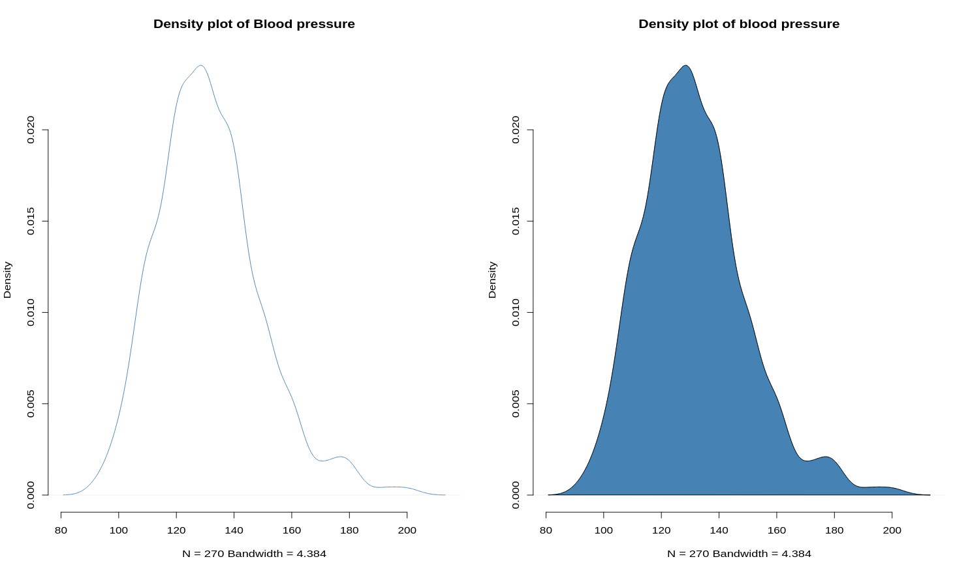
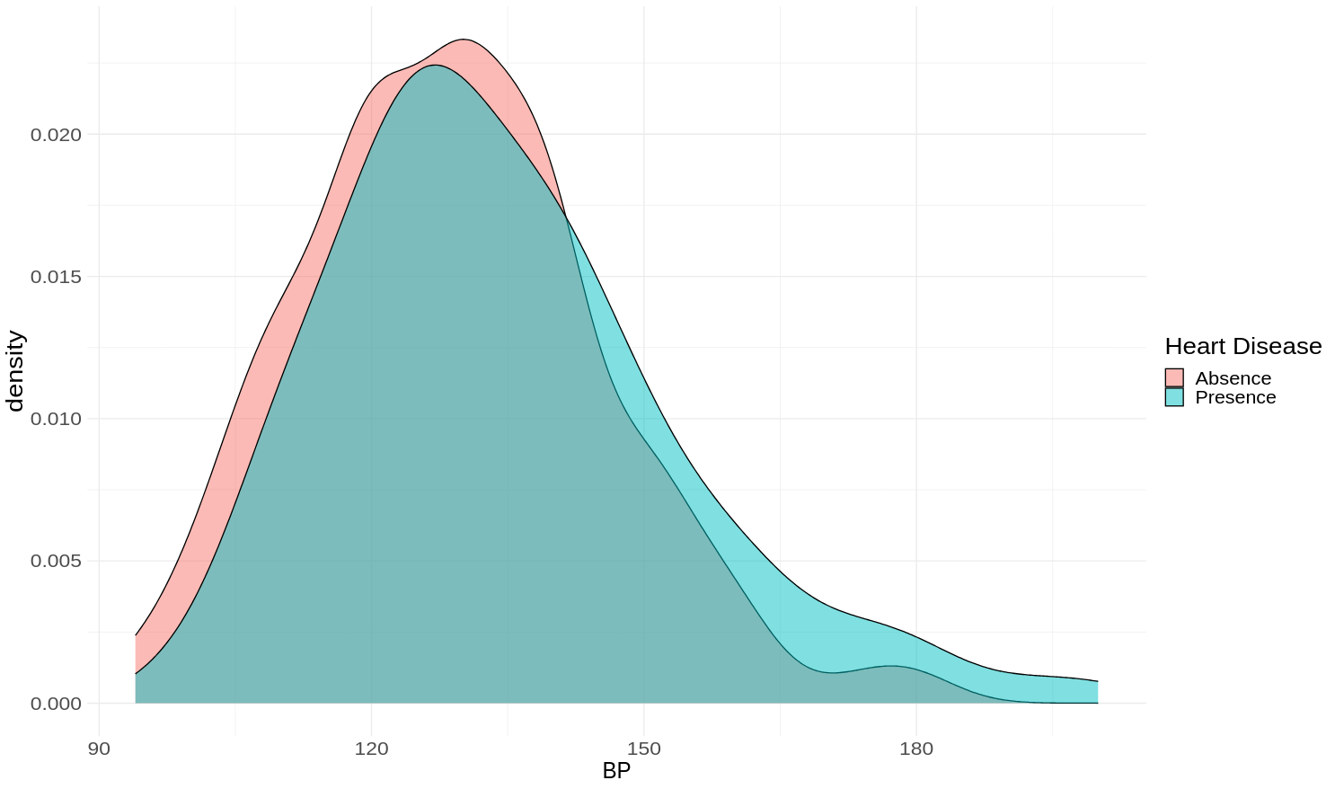
Density plot
Basic Plot
ggplot2 Plot
### Compute the density data
dens <- density(data$BP)
par(mfrow = c(1, 2))
### plot density
plot(dens, frame = FALSE, col = "steelblue",
main = "Density plot of Blood pressure"
)
### Fill the density plot using polygon()
plot(dens, frame = FALSE, col = "steelblue",
main = "Density plot of blood pressure"
)
polygon(dens, col = "steelblue")
ggplot(data, aes(BP, fill = Heart.Disease)) +
geom_density(alpha = 0.5) +
theme_minimal() +
theme(text = element_text(size = 20)) +
guides(fill = guide_legend(title = "Heart Disease"))

Slide 31
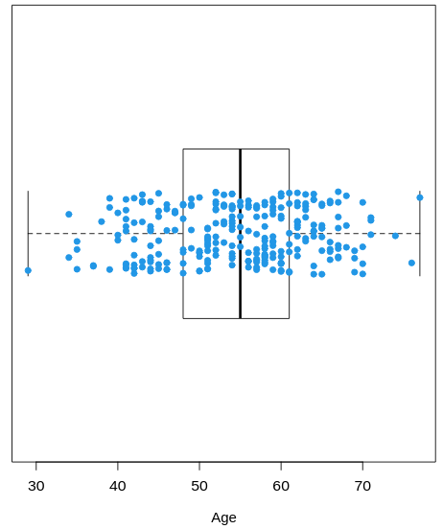
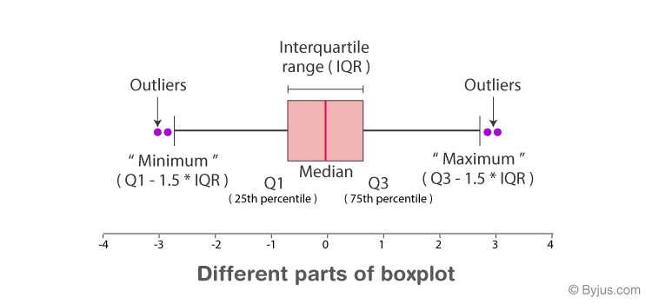
Box and violin plots

Slide 32
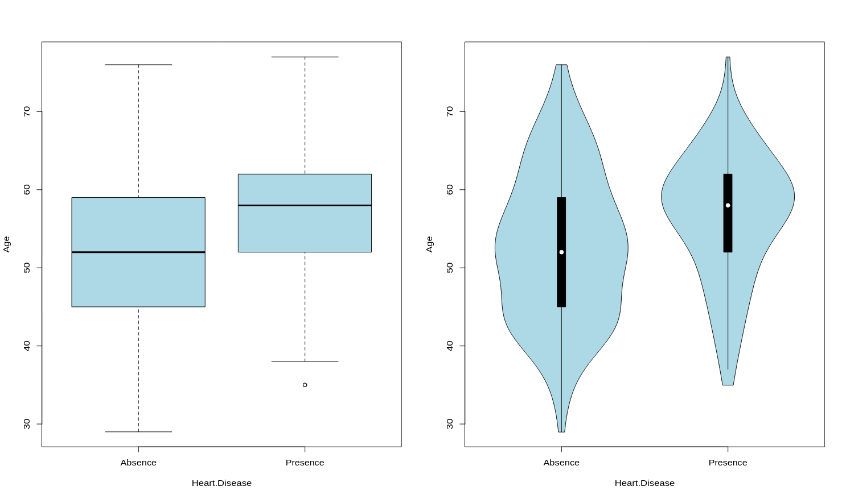
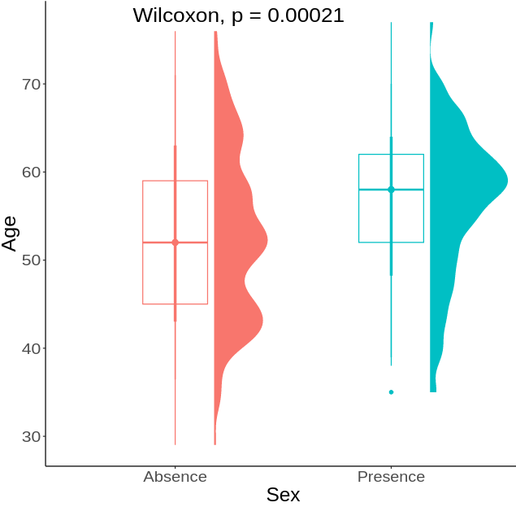
Box and violin plots
Basic Plot
ggplot2 Plot
ggplot(data, aes(x = Heart.Disease, y = Age, col = Heart.Disease)) +
geom_boxplot(width = 0.3) +
stat_compare_means(size = 7) +
theme_classic() +
labs(x = "Sex") +
theme(legend.position = "NULL") +
theme(text = element_text(size = 20)) +
ggdist::stat_halfeye(aes(fill = Heart.Disease),
adjust = 0.5, justification = -0.5, width = 0.4)
par(mfrow = c(1, 2))
boxplot(Age ~ Heart.Disease, data = data, col = "lightblue")
vioplot(Age ~ Heart.Disease, data = data, col = "lightblue")
dev.off()

Slide 33
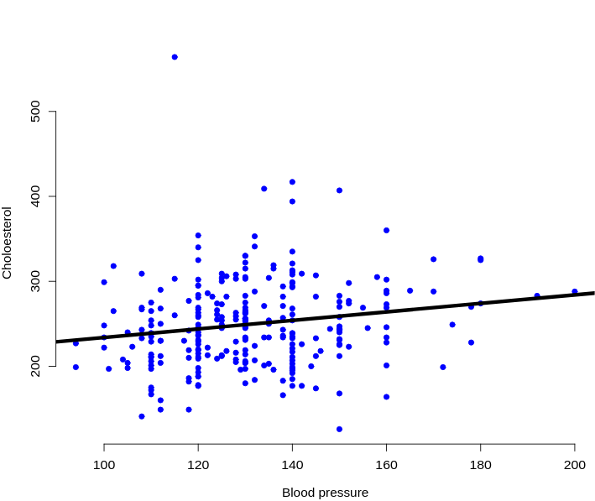
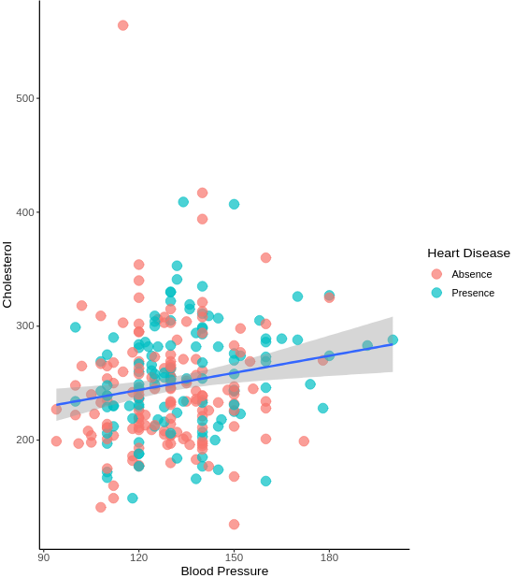
Scatter Plots add text
Basic Plot
ggplot2 Plot
x <- data$BP
y <- data$Cholesterol
plot(x, y,
xlab = "Blood pressure",
ylab = "Choloesterol",
pch = 19, frame = FALSE, col = "blue")
abline(lm(y ~ x, data = data),
col = "black", lwd = 5, lty = 1)
ggplot(data, aes(x = BP, y = Cholesterol)) +
geom_point(aes(col = Heart.Disease), size = 4, alpha = 0.7) +
geom_smooth(method = "lm") +
theme(text = element_text(size = 15)) +
theme_classic() +
labs(x = "Blood Pressure", col = "Heart Disease")

Slide 34
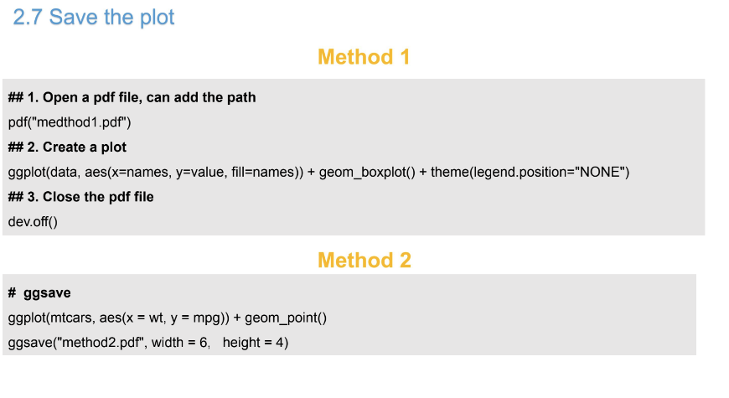
Save the plot

Slide 35

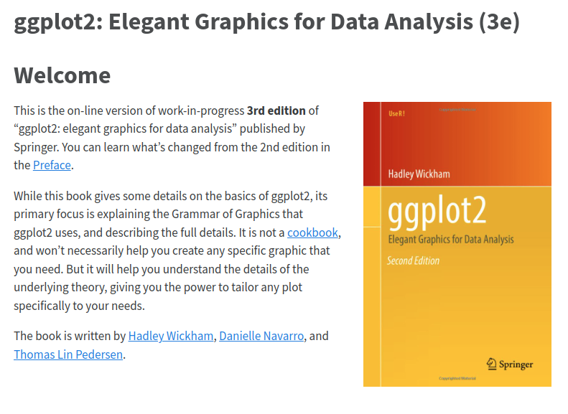
eBOOK
https://intro2r.com/
https://ggplot2-book.org/

Slide 36
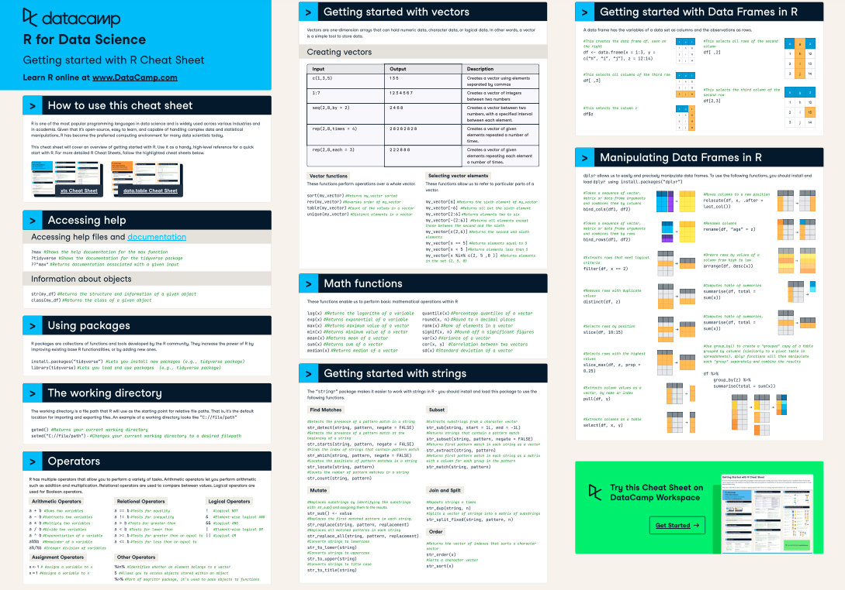
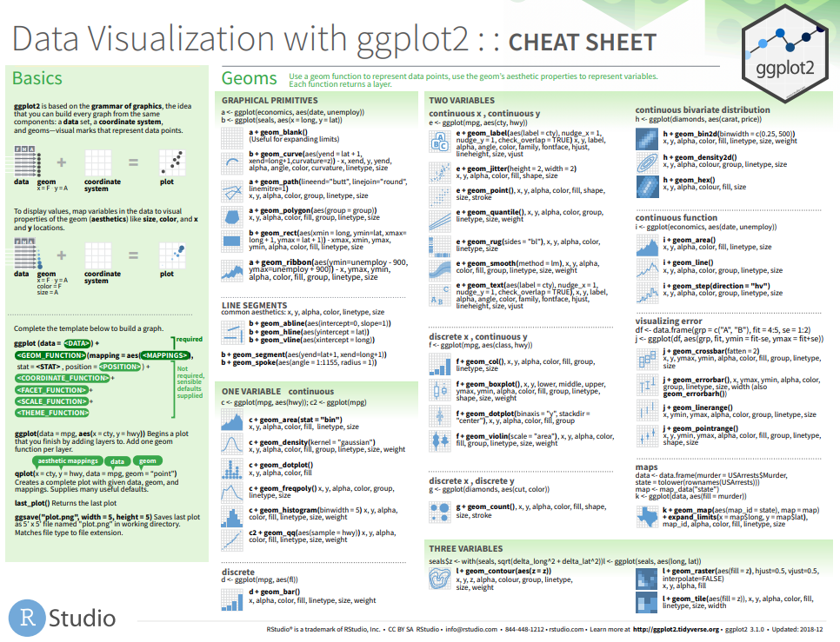
Cheetsheet
Cheetsheet for R
Cheetsheet for ggplot2
https://images.datacamp.com/image/upload/v1654763044/Marketing/Blog/R_Cheat_Sheet.pdf
https://www.maths.usyd.edu.au/u/UG/SM/STAT3022/r/current/Misc/data-visualization-2.1.pdf

Slide 37


Slide 38
